Slide 1
Scribe A Natural Language Processing And Generation Engine
Vandita Shah
Sumer Shende
Vineet Trivedi
Rishabh Vig

Slide 2
Introduction : the current scenario in journalism
The role of a journalist and the current race against time.
News organizations these days looking to minimize the time, cost and effort over news reporting and writing

Slide 3
Introduction : our choice of domain and project
Owing to these factors, we decided to choose the domain of Artificial intelligence to take this issue on as a challenge.
Our project is titled 'Scribe’, a word that literally means a writer or a record keeper.
Our system will be an automated journalist system that will write articles for the user automatically based on a specific set of minimal information that entered into the system.
The aim here to eliminate the additional human task of reporting on a specific news event, especially when a human is unavailable, thus simplifying the writing of news articles
Our system will learn how to write these articles based on previous articles that are fed to the system.

Slide 4
Our proposed system
We proposed a system that will learn how to write articles based on previous articles that are fed to the system.
In each of these previous collection of articles, each sentence will be deconstructed, tagged and dependencies found.
This will be stored in the database.
Now the system will accept a basic input , in our case, a scorecard of a match. Based on this scorecard, the system will import important elements to read from the score card, use the existing database and form sentences for the data.

Slide 5
Our proposed system: A basic visual block diagram for ‘Scribe’
Sachin scored 100 runs on 66 balls
System
System learns
Natural language understanding
Enter raw data:
Output:
Kohli scored 66 runs on 30 balls
“kohli”, “66 runs”, “30 balls”
Natural language generation

Slide 6
phases of SCRIBE
Natural language
understanding
Natural language
generation
The part of the system that learns the English language syntax
The part of the system that gives the output in English language, based on raw data on the news events.

Slide 7
Detailed concept
With the help of Stanford NLP libraries, we have designed a Parser v1.0 for our project that will tokenize the text.
This tokenized input data will be sent to our database used here.
The database that we have used in our project will be MongoDB database.
This data will be formatted using a mongoDB formatter
Now for the input side, we have designed the Realized engine of this system.
The realizer will accept data input from the user, map this input to the previous sentence structures stored in the database.
Based on that, new sentences will be formed by the Simple NLG module that we have used to produce sentences.

Slide 8
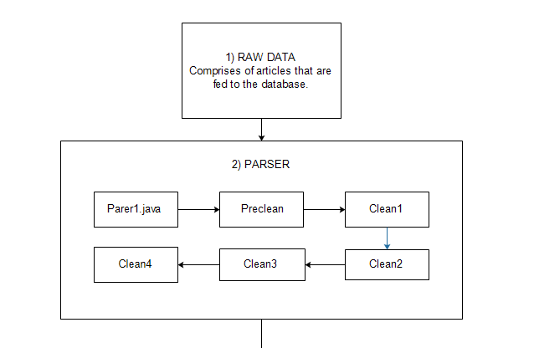
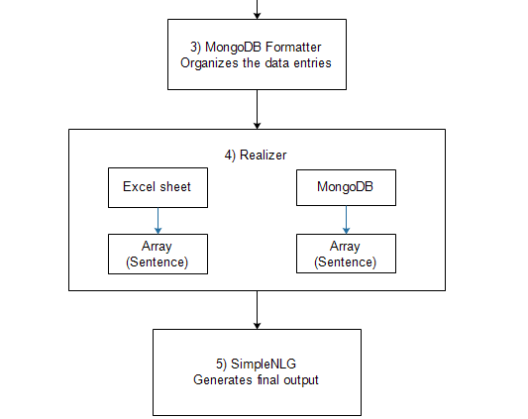
Implemented flow of the system

Slide 9
Implementation of the system parser
we now will begin with the implementation aspect of the project
Parsing
Also known as syntax analysis, consists of dividing a text in syntactically correlated parts of words. It leads to formation of a tree that would tell you how exactly these words are joining together to make the overall sentence. Components of parsing include:-
Text Segmentation
Divides written text into meaningful units by detecting the punctuation marks or full stop.
Tokenization
It is the process of breaking a stream of text up into words, phrases, symbols, or other meaningful elements called tokens

Slide 10
Implementation of the system parser
POS Tagging
Marks tokens with corresponding word type based like noun or an adverb
Lemmatization
It is the process of grouping together the different forms of a word. Eg. Walk can be walking, walks etc.

Slide 11
Implementation of the system parser
Parser v1.0
This is the first module of our project. It consists of 5 subtasks:
Preclean- In this step, symbols like #, $, etc. are replaced by a space.
Clean1- Processing leads to formation of trees consisting to various attributes of each word. The data is simplified in the following manner.
Clean2- Here the extra dependency trees which are not useful to the system are removed.
Clean3 and Clean4- Both these tasks work together by querying each other and convert the dependency trees to a format which can be interpreted by mongo DB.

Slide 12
Implementation of the system parser (Eg:- India scored 100 runs quickly.)
$$FILENAME=Iinput2.txt$$ Sentence #1 (6 tokens, sentiment: Neutral): India scored 100 runs quickly. [Text=India CharacterOffsetBegin=0 CharacterOffsetEnd=5 PartOfSpeech=NNP Lemma=India SentimentClass=Neutral] [Text=scored CharacterOffsetBegin=6 CharacterOffsetEnd=12 PartOfSpeech=VBD Lemma=score SentimentClass=Neutral] [Text=100 CharacterOffsetBegin=13 CharacterOffsetEnd=16 PartOfSpeech=CD Lemma=100 SentimentClass=Neutral] [Text=runs CharacterOffsetBegin=17 CharacterOffsetEnd=21 PartOfSpeech=NNS Lemma=run SentimentClass=Neutral] [Text=quickly CharacterOffsetBegin=22 CharacterOffsetEnd=29 PartOfSpeech=RB Lemma=quickly SentimentClass=Neutral] [Text=. CharacterOffsetBegin=29 CharacterOffsetEnd=30 PartOfSpeech=. Lemma=. SentimentClass=Neutral] (ROOT (S (NP (NNP India)) (VP (VBD scored) (NP (CD 100) (NNS runs)) (ADVP (RB quickly))) (. .))) root(ROOT-0, scored-2)nsubj(scored-2, India-1)nummod(runs-4, 100-3)dobj(scored-2, runs-4)advmod(scored-2, quickly-5)punct(scored-2, .-6)
Sentence #1 (6 tokens, sentiment: Neutral):India scored 100 runs quickly.[FILENAME=Iinput2.txt][Text=India PartOfSpeech=NNP Lemma=India SentimentClass=Neutral][Text=scored PartOfSpeech=VBD Lemma=score SentimentClass=Neutral][Text=100 PartOfSpeech=CD Lemma=100 SentimentClass=Neutral][Text=runs PartOfSpeech=NNS Lemma=run SentimentClass=Neutral][Text=quickly PartOfSpeech=RB Lemma=quickly SentimentClass=Neutral][Text=. PartOfSpeech=. Lemma=. SentimentClass=Neutral]root(ROOT-0, scored-2)nsubj(scored-2, India-1)nummod(runs-4, 100-3)dobj(scored-2, runs-4)advmod(scored-2, quickly-5)punct(scored-2, .-6)

Slide 13
The input file POS view
Sentence #1 (6 tokens, sentiment: Neutral): India scored 100 runs quickly. [FILENAME=Iinput2.txt] Text=India PartOfSpeech=NNP Lemma=India SentimentClass=Neutral root(ROOT-0, scored-2)nsubj(scored-2, India-1)nummod(runs-4, 100-3)dobj(scored-2, runs-4)advmod(scored-2, quickly-5)punct(scored-2, .-6)

Slide 14
MongoDB
What is MongoDB?
MongoDB is a cross-platform document-oriented database. Classified as a NoSQL database, MongoDB eschews the traditional table-based relational database structure in favor of JSON-like documents with dynamic schemas (MongoDB calls the format BSON), making the integration of data in certain types of applications easier and faster.
Why did we use MongoDB?
It accepts unstructured data.
The input files that we will send to the database will be unstructured
Also, mongoDB has data cleaning features that one can use for the data.

Slide 15
Implementation of the system MongoDB
The Parser program after all the cleaning phases, will send the data to MongoDB.
All data sent to MongoDB will be stored in JSON format.
In mongoDB we have collections similar to tables in RDBMS.
Each collection will have many documents
A document here in this case will be the sentences of the data sent to MongoDB.
Each document will have fields that we will use to store various attributes of the sentence
The next slide will consist of the attributes.

Slide 16
Contents and structure of MongoDB collection.
Pos:
Text:” “
Pos:” “
Lemma:” “
Sentiment” “
Dependencies:
Dependency:” “
Start:” “
End:” “
Id:” “
Sentence: ” “
Filename:” “
SentenceSentiment:” “

Slide 17
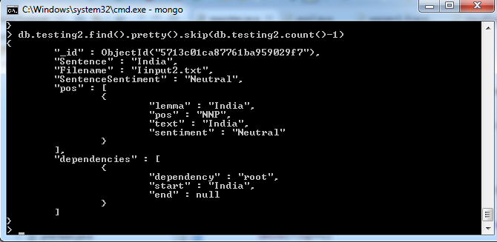
Implementation of the system MongoDB
Fig. MongoDB implementation

Slide 18
Features of our MongoDB system
Exception Handling :- Number, Array, MongoDrop, StringIO, MemoryLimitReached.
Dynamic building:- Incase of an error or exception, it handles and continues processing.
Formatting:- Partially executed queries are rollbacked and redone.

Slide 19
Implementation of the system User input and realizer engine
User gives an input excel (.xls) sheet
Following is the format of entry:
Player name | Runs Scored | Balls played | Overs | Runs in overs | Wickets | Catches
Rohit | 56 | 51 | 7 | 6 | 1 | 0
Ravi | 50 | 42 | 8 | 5 | 2 | 1
Player name | Runs Scored | Balls played | Overs | Runs in overs | Wickets | Catches
Pointing | 20 | 11 | 5 | 8 | 1 | 3
Warne | 55 | 48 | 10 | 10 | 1 | 2
Venue: | Wankhede Stadium, Mumbai
Match History Team 1: | WWL
Match History Team 2: | WLW
Toss Winner: | India
Decision: | Bat
Team 1 total: | 315/7
Team 2 total: | 310/6
MOTM | Rohit
Team 1 Name | India
Team 2 Name | Australia
Winner | India

Slide 20
Implementation of the system User input and realizer engine
We have built a JAVA program that uses the excel sheet as entered by the user.
The JAVA program will use Apache POI and xml beans libraries
The JAVA program will read the data from the excel sheet and form arrays as follows:
Array a[][] –Runs
Array b[][] –Overs
Array c[][] –Wickets
Array d[][] –Catches
Array names[] –Player Names

Slide 21
Implementation of the system User input and realizer engine
The same program will sort the respective arrays according to runs, wickets, catches etc.
This sorting is done to ensure that we can find the players with higher performances, which will be the main highlights of the article.

Slide 22
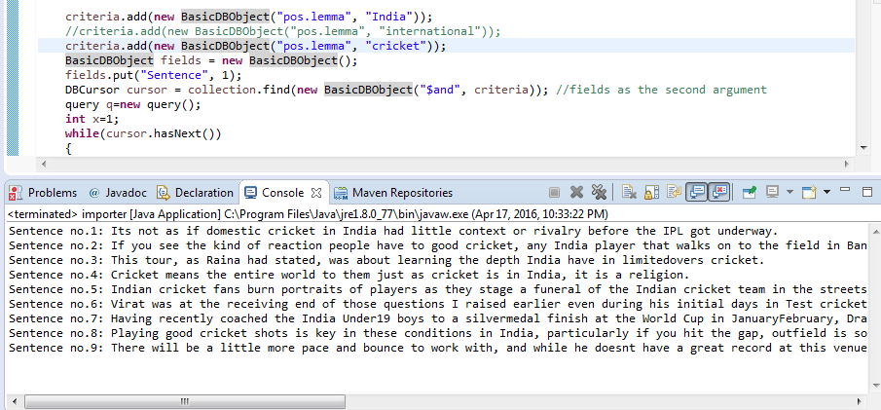
Implementation of the system User input and realizer engine
Elements obtained from the excel sheet are used to query the database in order to obtain remaining elements of the sentences.
Fig. querying the database.

Slide 23
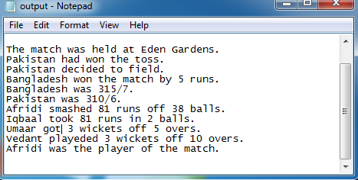
Implementation of the system User input and realizer engine
All the elements are put in an array and fed to the realizer to obtain the respective sentences.
Fig. generation of the sentences(producer.class)

Slide 24
From the basic users’ perpective
We allow our user to make a scorecard of a cricket match that will be located in the devices’ file system.
Based on entries in this file system that the user has entered, the system will read the file using a developed program, and will compose an article thru our system.
The excel sheet will be a scorecard that will contain all the important information and statistics of a cricket match.

Slide 25
Future scope
Scribe can expand its data sources. It can be made capable enough to draw raw data from sources like RSS feeds of multiple website, social media plug roots, blogging stations, news tickers etc.
By expanding its sources of data, the richness and quantity of data can be increased. For this, Scribe needs to be able to read text from different formats like XML, LateX along with grabbing the correct unformatted text from html documents.
Scribe’s use is not bounded to only cricket. Scribe can easily learn how to write articles on other sports like football, hockey, baseball etch
However the most important use of Scribe is the coverage of natural disasters. During natural disasters chances of human delay are high and the need to communicate the disaster and its consequences is of paramount importance.

Slide 26
Conclusion
In conclusion, the following system that we have implemented is still in a nascent stage and has wider potential to spread to more domains.
The concept if automation is however central to our project. As AI progresses it will be playing an important role in reducing human delay, cost, increasing efficiency, increasing output etc.
Our concept of an automated system has a specific domain, but if the scope is widened we may see the complete automation of journalistic writing as a whole, which will be the imminent future of journalism.

